Slide 1
Product Design Specification
Samuel Arseneault, Kelly Markaity, John Luu

Slide 2
Introduction
Define architecture and system design
Assist team with developing
Roles
Use cases
Diagrams
Notes:
For our presentation we are going to go through our Product Design Specification document and outline the main section of our document. For each section we will talk about some of the main components that we think are the most important.

Slide 3
Scope
Guideline for iOS application and web portal
Student Features
Teacher Features
Administrator Features
Notes:
Some of the features for the iOS application are navigation through different levels and having the ability to chose between practice and test sections.
Some of the features for the web portal that the teacher will be using are, creating a class, viewing students progress and adding new levels and questions to the iOS application.
Features for the web portal that the administrator will be using are, deleting/denying teacher accounts. As well as, clearing the whole system.

Slide 4
Assumptions/Constraints
Web portal and iOS app user friendly
Slow server speed
Student learning behavior
iOS 8 and Google Chrome
Notes:
Assumptions:
Teachers may have limited technological skill set so the web portal must be easy to use and user friendly.
First graders rely on patterns and visual cues to learn so the iOS application must be visually appealing and easy to use.
Business Constraints:
If our final product has a server hosted at wayne state university as opposed to server being hosted at graylings school. The communication between the application and web portal could be slow.
Technical Constraints: Application will work on iPads with iOS 8 and the web portal will function on google chrome. We will not have a huge server so if there are a lot of users for the system this could slow our system down.

Slide 5
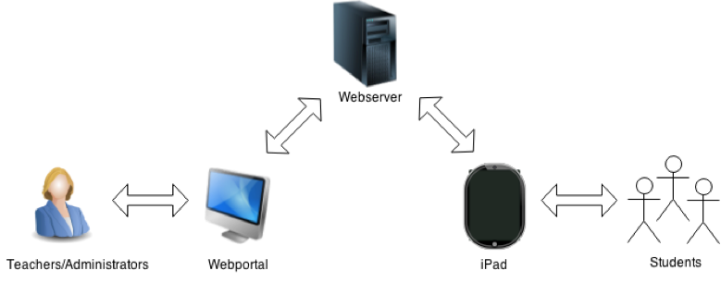
Hardware Architecture
Notes:
Math system is set up on public network where the iOS application and web portal will be connected to the same server.

Slide 6
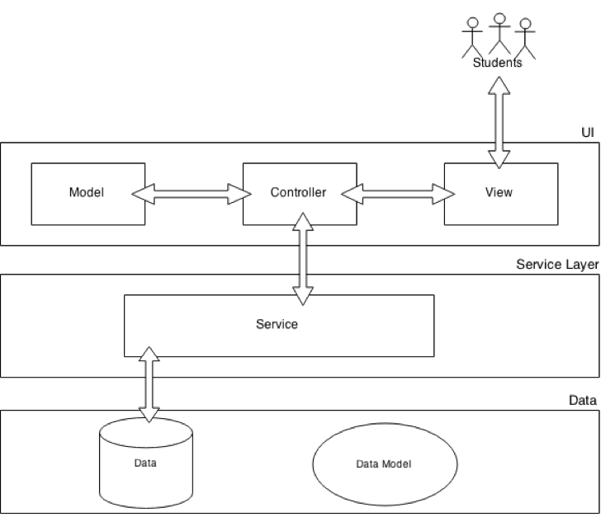
Software Architecture iOS
Notes:
Section 3.3.1
iOS application is built using xCode which using a MVC design pattern. MVC stands for Model, View and Controllers.
The controllers communicate between the model and view layers and also, requests data from service layer.
Model stores and provides methods for data. While the view is responsible for UI.

Slide 7
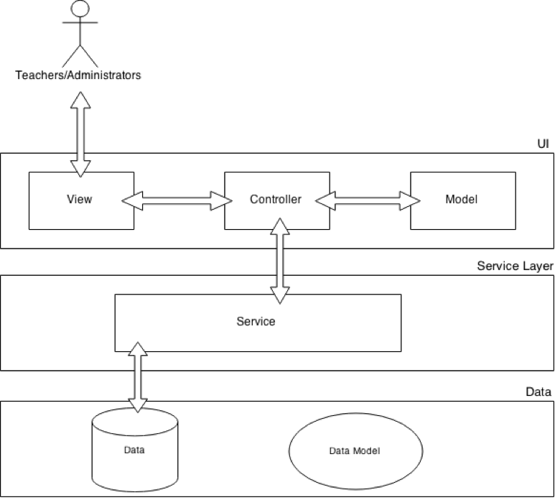
Software Architecture Portal
Notes:
Section 3.3.2
Similar MVC design as the iOS application. ADD MORE NOTES

Slide 8
iOS Send and Receive Data
JSON Format:
"Table Name":[
{"Column 1":"Record 1 data", "Column 2":"Record 1 data"},
{"Column 1":"Record 2 data", "Column 2":"Record 2 data"},
{"Column 1":"Record 3 data", "Column 2":"Record 3 data"}
]}
Level Information:
{"Level":[
{"level_id":"0...n", "name":"ABC", "time_limit":"min:sec",
"description":"ABC","testq_set":"T-F", "num_tquestions":"0...n"}
]}
Notes:
Our system will be using JSON objects to format data when sending and receiving data. So what is JSON? JSON stands for JavaScript Object Notation and is basically just a string notation for a dictionary. Its lightweight and its easy for us humans to understand. Its also not difficult for machines to parse through.
As you can see above, if we were to store a database table information it would look like the above notation. It begins with table name then inside of the brackets there are columns in red and the stored information in blue. For an example we will be sending level information to and from the iOS application, it would look like this. Level, level_id, name….
What's nice about using JSON is PHP has a built in json_encode an json_decode function which will take in array or a json object and output the reverse.

Slide 9
Portal Send and Receive Data
Uses php instead of json
Same principle as iOS application sending and reciving data
Notes:
The web portal will also send and receive level, question, and student level progress information. However, the web portal will not be using JSON formatting, since querying the database will written in PHP, the web portal will eliminate the JSON formatting step and just store result sets in a string or an array.

Slide 10
Security Architecture
SSL Encryption
Identification
Storing Credentials
Notes:
SSL(Secure Sockets Layer) If the web portal is communicating with the server or the iOS application is communicating with the server, the encryption and identification process will be the same.
Encryption steps:
1) Server and device agree on encryption
2)Server sends certificate
3)Device requests to start encrypting
4) Server requests the device to start encrypting
5) Final, total encryption
Identification steps:
1) Company asks CA for a certificate
2) CA creates certificate and signs it
3) Certificate installed in server
4) Browser issued with root certificates
5) Browser trust correctly signed certs
Storing Credentials: All credentials will be stored in database using salting and hashing on the password to ensure security.

Slide 11
User Roles
Actors:
Administrator
Teacher
Student
Notes:
For our use cases, we have 3 user types.
Administrator: Is created by default and will have access to the whole system.
Teacher: Assigned teacher role by creating account
Student: Assigned student role by teacher creating student account.

Slide 12
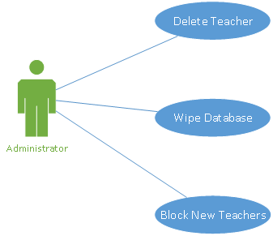
Administrator Role
Notes:
An administrator will be able to delete a specific teacher, wipe the database, or block new teachers from creating accounts.

Slide 13
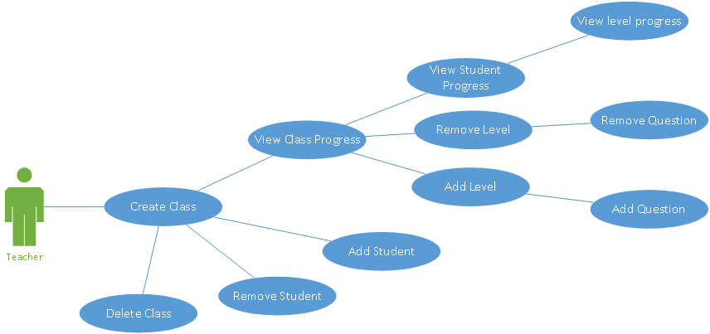
Teacher Role
Notes:
A teacher will have the ability to create/delete classes, as well as adding or removing students from those classes. Teachers will also be able to add/remove levels and questions, and view the progress of their students.

Slide 14
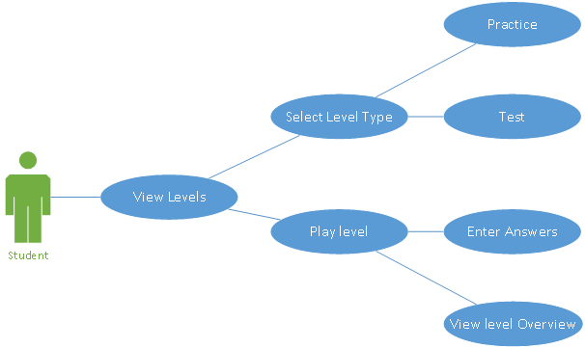
Student Role
Notes:
A student will be able to view levels, select the type of level, and then actually play the level where the enter answers.

Slide 15





Teacher Use Case
Teacher creates a class:
Preconditions: Normal Flow: Postconditions:
Existing Account
Valid Session
Using Chrome
Internet Connection
Teacher Name
Teacher successfully creates a class
ClassName
Class Password
Create Class
Notes:
So lets go through one of the uses cases for each of the different users.

Slide 16

Admin Use Case
Admin deletes a teacher:
Preconditions: Normal Flow: Postconditions:
Teacher Acc. Exists
Valid Session
Using Chrome
Internet Connection
Teacher Menu
Admin successfully deletes a teacher
Teacher | Id
Mr. A | 1
Mrs. B | 2
D3.js
Delete Teacher

Slide 17

Student Use Case
Student Selects Practice Mode:
Preconditions: Normal Flow: Postconditions:
Existing Account
Valid Session
Using Chrome
Internet Connection
Student successfully enters the practice mode
Desired Level
Controller
View
Practice

Slide 18
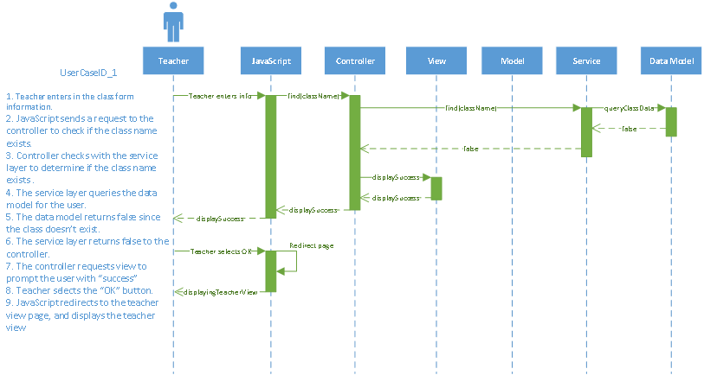
Sequence Diagram
Notes:
Teacher creates a class sequence diagram

Slide 19
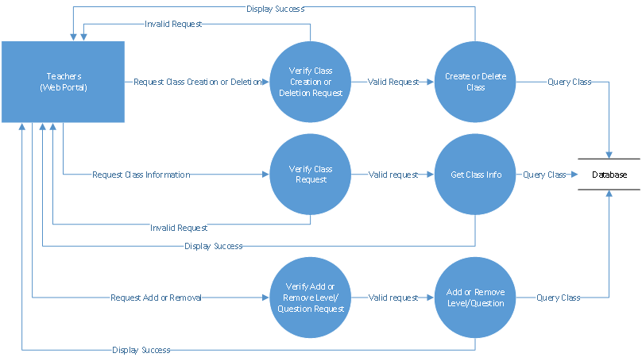
Teacher Data Flow Diagram

Slide 20
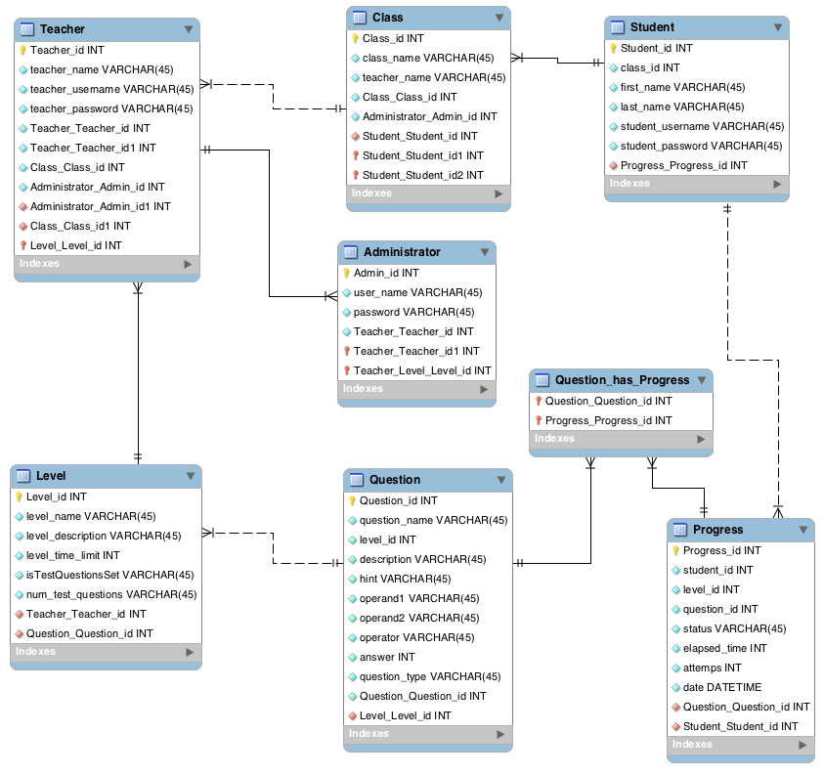
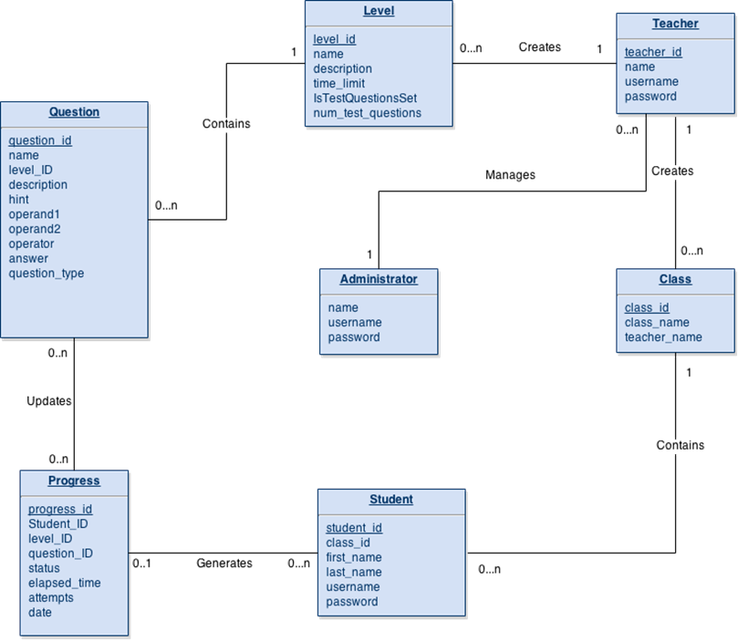
Database Design

Slide 21
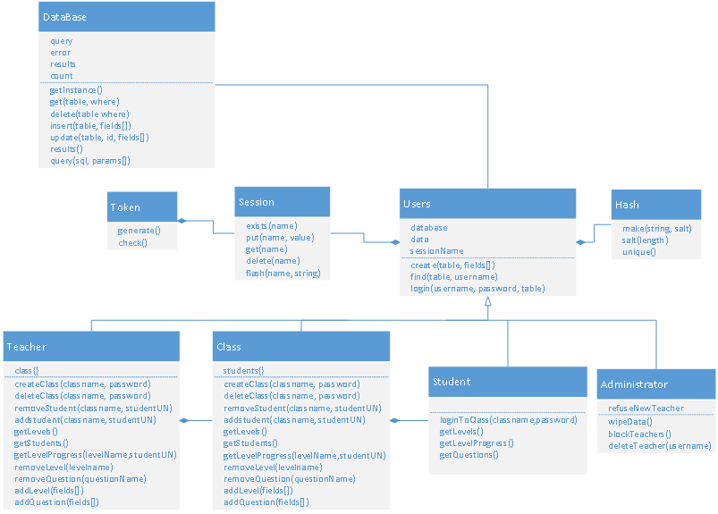
Class Diagram
Notes:
This is the class diagram for the web portal. For all users its standard to have a database, session, data and to use functions such as create, find, or login. This is common among teachers, students and administrators.

Slide 22
Questions ?

